Slide 1

Lecture 2: Physical and Data Link Layer (Computer Network)
Computer Network
Dr. Shashi Bhushan

Slide 2

The OSI Model: Foundation of Network Communication
What is the OSI Model?
Developed by ISO (International Standards Organization).
A conceptual framework to understand network interactions.
Divides network functions into 7 layers.
01
Dr. Shashi Bhushan

Slide 3
7 – Layers of ‘OSI Model’
7 - Layers of the OSI Model (Top to Bottom):
Application – Interface for user interaction.
Presentation – Data translation, encryption, compression.
Session – Session management between systems.
Transport – Reliable data transfer (TCP/UDP).
Network – Routing and addressing (IP).
Data Link – Node-to-node error-free transmission.
Physical – Raw bit transmission over a physical medium.
02
Dr. Shashi Bhushan

Slide 4
Responsibilities of Physical Layer
Layer 1 – Physical Layer:
Transmits raw bits over physical medium (0s and 1s)
Responsible for electrical/optical signals, voltages, pin layout
Defines connectors, cable types, and transmission rates
Examples: Ethernet cables, Fiber optics, Hubs, Repeaters
03
Dr. Shashi Bhushan

Slide 5
Responsibilities of Data Link Layer
Layer 2 – Data Link Layer:
Ensures reliable point-to-point (node-to-node) delivery
Handles framing, addressing (MAC), and error detection
Controls access to shared media (via MAC protocols)
Examples: Ethernet, PPP, Frame Relay
04
Dr. Shashi Bhushan

Slide 6
Responsibilities of Physical Layer and Data Link Layer [Both]
Layer 1 & 2 Interaction:
DLL packages data into frames
Physical layer converts frames into signals
Together, they ensure data is prepared for transmission across networks
05
Dr. Shashi Bhushan

Slide 7
How Layer 1 and Layer 2 Work Together(a)
Data Encapsulation Overview:
Application data → Segmented by Transport Layer → Packets at Network Layer
At Data Link Layer: → Packet is encapsulated into a Frame → Frame = [Header | Payload | Trailer] → Header contains MAC address, control info
At Physical Layer: → Frame is converted into electrical, optical, or radio signals
06
Dr. Shashi Bhushan

Slide 8
How Layer 1 and Layer 2 Work Together(b)
Transmission Flow:
Sender:
Receiver:
Example:
Ethernet Frame: MAC Header | IP Packet | FCS (CRC)
Bit stream (Layer 1) is interpreted and rebuilt as Frame at Layer 2
Data
Bits
Signal
Frame
Signal
Frame
Data
Bits
07
Dr. Shashi Bhushan

Slide 9
Learning Objective(s)
Understand:
The roles and functions of the Physical and Data Link layers in the OSI model
Types of transmission media (wired and wireless)
Switching techniques: circuit, packet, and message switching
How framing is performed at the Data Link Layer
Analyse:
Error detection techniques: parity, checksum, CRC, and Hamming code
Flow control and MAC (Medium Access Control) protocols
How data travels through layers using encapsulation and decapsulation
Apply:
Use command-line tools (e.g., ping, tracert, netstat, get-mac) to analyse Layer 1/2 behaviour
Identify appropriate transmission mediums for network scenarios
Evaluate switching types based on use case
Activities:
CLI demos, matching tables, calculations, protocol simulations, case studies, MCQs
08
Dr. Shashi Bhushan

Slide 10
Transmission Media – Introduction
Transmission Media – The Physical Path of Data
Ques. What is Transmission Media?
Ans: It is the physical pathway that carries communication signals from one device to another.
Categorized into: → Wired (Guided Media) → Wireless (Unguided Media)
09
Dr. Shashi Bhushan

Slide 11
Transmission Media – Categories(a)
Guided (Wired) Media:
Uses tangible physical paths like cables
Examples: Twisted Pair, Coaxial Cable, Fiber Optic Cable
Unguided (Wireless) Media:
Uses air or space for signal transmission
Examples: Radio waves, Microwaves, Infrared, Satellite
10
Dr. Shashi Bhushan

Slide 12
Transmission Media – Categories(b)
Importance in Physical Layer:
Determines speed, signal quality, range, and reliability
Critical for bandwidth planning and physical topology
Parameters Influenced by Media:
Bandwidth
Attenuation (signal loss)
Noise Immunity
Cost and ease of installation
11
Dr. Shashi Bhushan

Slide 13
Twisted Pair Cable(a)
Ques. What Is Twisted Payer Cable?
Ans. A type of guided medium consisting of pairs of insulated copper wires twisted together. Reduces electromagnetic interference (EMI) and crosstalk.
Types of Twisted Pair:
Unshielded Twisted Pair (UTP): a. Common in LANs; b. Cheaper, flexible, but more susceptible to noise
Shielded Twisted Pair (STP): a. Has metallic shielding; b. Better noise resistance, slightly more expensive
12
Dr. Shashi Bhushan

Slide 14
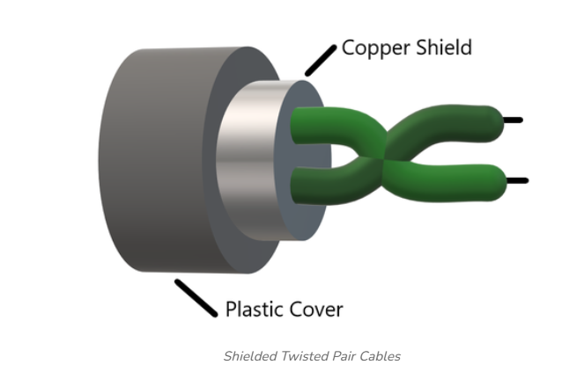
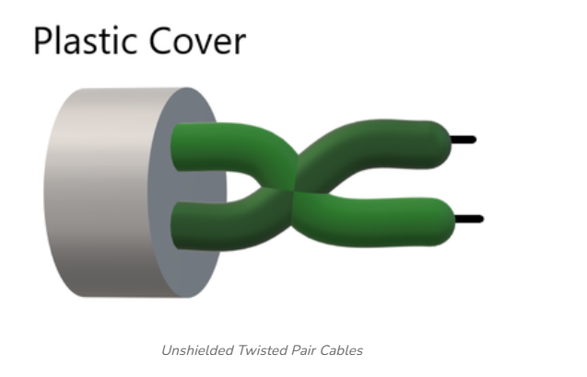
Twisted Pair Cable(b)
Characteristics:
Bandwidth: Up to 10 Gbps (with Cat 6a/7)
Max length: ~100 meters (without signal degradation)
Easy to install and terminate
Use Cases:
Ethernet LANs (10BASE-T, 100BASE-TX, etc.)
Telephone networks
13
Dr. Shashi Bhushan

Slide 15
Coaxial Cable(a)
Ques. What Is Coaxial Cable?
Ans. A guided transmission medium with a central copper conductor. It is Surrounded by an insulating layer, metallic shielding, and outer plastic jacket. It is Designed to protect signals from electromagnetic interference (EMI).
Structure Layers: a. Inner conductor (copper); b. Dielectric insulator; c. Metallic shield (braid or foil); d. Outer plastic cover
14
Dr. Shashi Bhushan

Slide 16
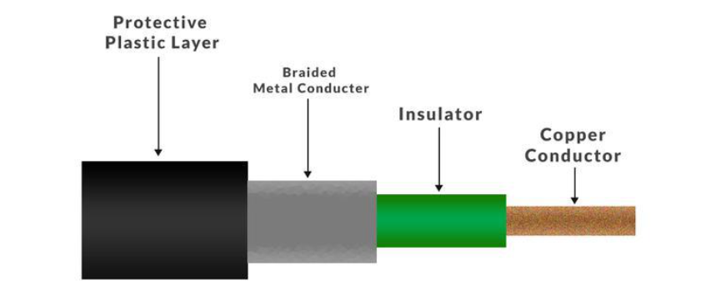
Coaxial Cable(b)
Characteristics:
Higher noise immunity than twisted pair
Bandwidth: Up to several GHz
Supports Analog and digital signals
Longer distance support than UTP
Use Cases:
Cable TV distribution
Internet (broadband DOCSIS networks)
CCTV systems
Legacy Ethernet (10BASE2, 10BASE5)
Example:
RG-6 Coaxial Cable used in home broadband setups
15
Dr. Shashi Bhushan

Slide 17
Fiber Optic Cable(a)
Ques. What Is Fiber Optic Cable?
Ans. A guided medium that transmits data as pulses of light through glass or plastic fibers. It Immune to electromagnetic interference (EMI). Also Ideal for long-distance, high-bandwidth communication.
Structure:
Core – Thin glass center where light travels
Cladding – Reflects light back into core
Buffer Coating – Protective outer layer
16
Dr. Shashi Bhushan

Slide 18

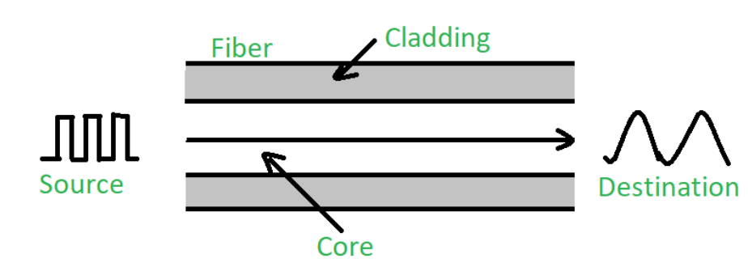
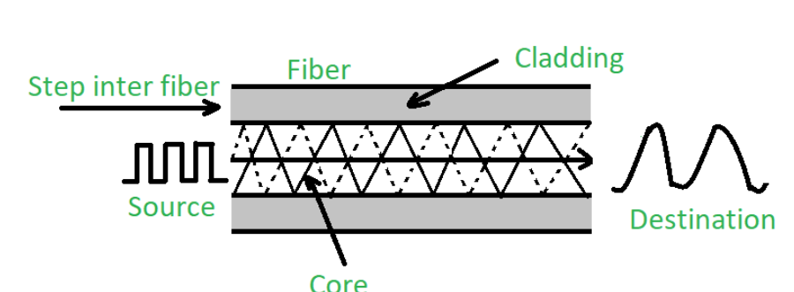
Fiber Optic Cable(b)
Types of Fiber:
Single-Mode Fiber (SMF)
a. Thin core (~9 μm).
b. Long-distance transmission (up to 100 km+)
c. Used in telecom backbones
Multi-Mode Fiber (MMF)
a. Thicker core (~50–62.5 μm)
b. Shorter distances (~2 km)
c. Used in LANs and campus networks
17
Dr. Shashi Bhushan

Slide 19
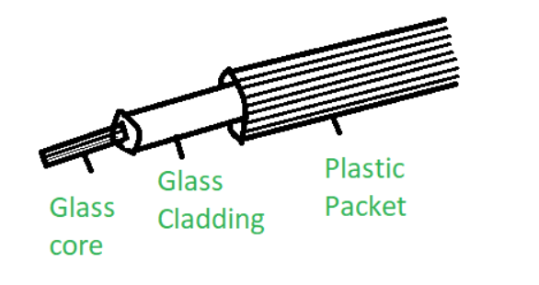
Fiber Optic Cable(c)
Characteristics:
Bandwidth: 10 Gbps to 100 Gbps+
Range: 2 km (MMF) to 100 km+ (SMF)
Immune to EMI, secure, lightweight
More expensive and delicate than copper cables
Use Cases:
Internet backbone infrastructure
Data centers, ISPs, submarine cables
Example:
SMF used in a 5G cellular backhaul network
MMF in enterprise campus backbone
18
Dr. Shashi Bhushan

Slide 20
Comparison of Transmission Media(s)
Feature | Twisted Pair (UTP/STP) | Coaxial Cable | Fiber Optic Cable
Medium Type | Copper Wires | Copper Core + Shield | Glass/Plastic Fiber
Transmission Speed | Up to 10 Gbps (Cat 6a/7) | Up to 1 Gbps+ | 10 Gbps to 100 Gbps+
Maximum Distance | ~100 meters | ~500 meters (without repeaters) | 2 km (MMF) – 100+ km (SMF)
EMI Resistance | Low to Moderate (better in STP) | High | Very High (Immune)
Cost | Low | Moderate | High
Flexibility & Installation | Easy | Moderate | Difficult
Use Cases | LANs, Telephony | Cable TV, CCTV, Broadband | Backbone, ISP, Data Centers
19
Dr. Shashi Bhushan

Slide 21
Cost, Attenuation & Performance Factors
Q. What Influences Media Performance?
Cost: 1. Initial installation cost; 2. Maintenance and replacement; 3. Fiber is expensive; twisted pair is budget- friendly
Attenuation (Signal Loss): 1. Decrease in signal strength over distance; 2. Coaxial has less attenuation than twisted pair; 3. Fiber has the lowest attenuation (best for long range)
Bandwidth: 1. Max amount of data that can be transmitted per unit time; 2. Fiber offers highest bandwidth; 3. Twisted pair supports sufficient bandwidth for typical LANs
Noise Susceptibility: 1. Interference from external sources (EMI, crosstalk); 2. Shielded cables reduce noise (STP, coaxial); 3. Fiber is immune
Flexibility and Ease of Installation: 1. Twisted pair: easy to bend, terminate; 2. Coaxial: rigid but manageable; 3. Fiber: fragile and requires specialized tools
Example Scenario:
- A campus LAN with short distances = Twisted Pair (Cat6).
- Long-distance connection between cities = Single-mode Fiber
20
Dr. Shashi Bhushan

Slide 22
Wireless Transmission Media – Overview
What Is Wireless Media?
Transmission of signals through air using electromagnetic waves
No physical conductor; relies on antennas and frequencies
Classified as unguided transmission
Key Features:
Mobility and flexibility
Ideal for difficult-to-wire environments
More prone to interference, weather, and security concerns
21
Dr. Shashi Bhushan

Slide 23
Wireless Transmission Media – Types
Common Wireless Transmission Types:
Radio Waves
Frequency: 3 kHz to 1 GHz
Used in FM radio, mobile phones, Wi-Fi
Microwaves
Frequency: 1 GHz to 300 GHz
Used in satellite links, cellular networks, line-of-sight communication
Infrared (IR)
Frequency: ~300 GHz to 400 THz
Short-range communication: TV remotes, IR sensors
22
Dr. Shashi Bhushan

Slide 24
Wireless Transmission Media - Use cases
Characteristics:
Shared medium — subject to congestion and collisions
Speed depends on frequency band and technology (e.g., Wi-Fi 6 = 9.6 Gbps theoretical max)
Example:
Office wireless LAN using 802.11ax (Wi-Fi 6)
Satellite Internet in rural locations using Ku-band microwave
23
Dr. Shashi Bhushan

Slide 25
Radio Waves(a)
What Are Radio Waves?
Electromagnetic signals with frequencies between 3 kHz and 1 GHzTransmit data through air in all directions (omnidirectional)Do not require line-of-sight between sender and receiver
Characteristics:
Long wavelength; can pass through walls and buildings
Suitable for both short and long-distance communication
Low-frequency signals can diffract around obstacles (buildings, terrain)
24
Dr. Shashi Bhushan

Slide 26
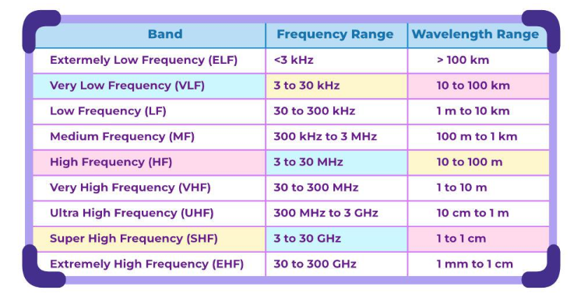
Radio Waves(b)
Applications:
AM/FM Radio Broadcasting
Television Broadcasting (analog/digital)
Cordless Phones
Wi-Fi (2.4 GHz band)
Bluetooth (2.4 GHz)
Example:
A home Wi-Fi router using 2.4 GHz radio waves to cover multiple rooms
25
Dr. Shashi Bhushan

Slide 27
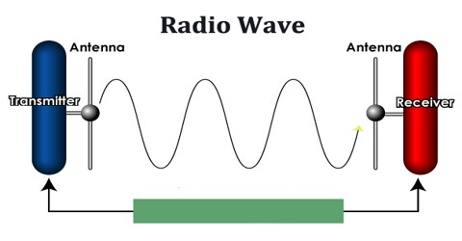
Radio Waves(c)
Advantages:
Wide area coverage.
Penetrates non-metallic obstructions.
Inexpensive deployment for low-power
Communication.
Limitations:
Susceptible to interference and jamming.
Limited security unless encryption is applied.
Lower bandwidth compared to higher-frequency media.
26
Dr. Shashi Bhushan

Slide 28
Microwaves(a)
What Are Microwaves?
Electromagnetic waves with frequencies between 1 GHz and 300 GHz.
Typically used in point-to-point wireless communication.
Requires clear line-of-sight between transmitter and receiver.
Characteristics:
Shorter wavelength than radio waves.
Cannot easily penetrate buildings or terrain.
High directional focus = lower interference.
27
Dr. Shashi Bhushan

Slide 29
Microwaves(b)
Applications:
Satellite communication (uplink/downlink)
Cellular networks (e.g., 4G LTE backhaul)
Microwave links for long-distance backbone
Wi-Fi 5 GHz and 6 GHz bands (part of microwave spectrum)
Example:
Microwave tower relays internet backbone signals between two cities.
28
Dr. Shashi Bhushan

Slide 30
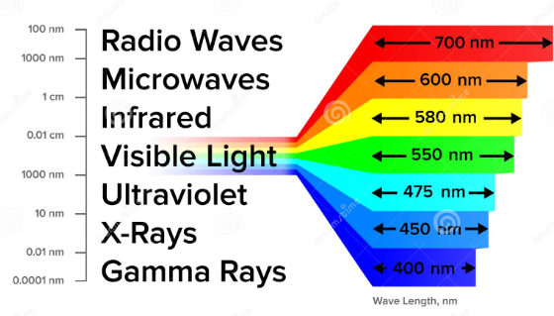
Microwaves(c)
Advantages:
High bandwidth, suitable for high-speed data
Focused beam limits signal leakage
Used where fiber deployment is expensive or impractical
Limitations:
Weather-dependent (rain fade, fog impact)
Requires alignment and clear path
More expensive setup than radio wave solutions
29
Dr. Shashi Bhushan

Slide 31
Infrared Transmission(a)
What Is Infrared?:
Electromagnetic waves with frequencies just below visible light (~300 GHz to 400 THz)
Used for very short-range, point-to-point communication.
Requires line-of-sight; blocked by walls and obstacles
Characteristics:
Highly directional
Low interference from nearby
penetrate solid objects (walls, furniture)
30
Dr. Shashi Bhushan

Slide 32
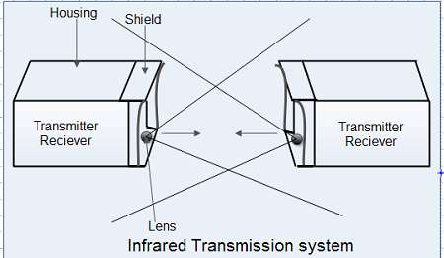
Infrared Transmission(b)
Applications:
TV remote controls
Wireless keyboards/mice
IR data transfer between phones (legacy)
Infrared sensors in automation systems
Example:
TV remote control using IR signals to send commands to the television
31
Dr. Shashi Bhushan

Slide 33
Infrared Transmission(c)
Overview:
Secure (confined beam, unlikely to be intercepted)
Low power consumption
No license required
Limitations:
Must be aligned properly (no obstacles)
Limited range (typically < 5 meters)
Affected by sunlight or ambient IR sources
32
Dr. Shashi Bhushan

Slide 34
Modern Wireless Technologies(a)
Overview:
These are common wireless technologies used in homes, businesses, and mobile networks. They vary in range, speed, and application.
Wi-Fi (Wireless Fidelity):
Based on IEEE 802.11 standards
Operates in 2.4 GHz and 5 GHz bands (newer: 6 GHz with Wi-Fi 6E)
Typical range: ~50 meters indoors
Speed: Up to 9.6 Gbps (Wi-Fi 6)
Use Case: Home/Office internet access, mobile connectivity
33
Dr. Shashi Bhushan

Slide 35
Modern Wireless Technologies(b)
Bluetooth:
Short-range wireless standard for personal devices
Operates in 2.4 GHz ISM band
Range: ~10 meters (Class 2); up to 100 meters (Class 1)
Speed: ~2 Mbps (Bluetooth 5.0+ supports more)
Use Case: Headphones, wearables, file transfer
3. 5G (Fifth Generation Mobile Network):
Operates across low (sub-1 GHz), mid (1–6 GHz), and high (mmWave: 24–100 GHz) bands
Speed: 100 Mbps to 10 Gbps+
Ultra-low latency (<1 ms)
Use Case: Smart cities, IoT, autonomous vehicles, high-speed mobile internet
34
Dr. Shashi Bhushan

Slide 36
Wireless Media – Security, Range & Performance
Feature | Radio Waves | Microwaves | Infrared | Wi-Fi | Bluetooth | 5G
Frequency | 3 kHz–1 GHz | 1–300 GHz | ~300 GHz–400 THz | 2.4 / 5 / 6 GHz | 2.4 GHz | <1 – 100 GHz
Range | Long | Medium–Long (LOS) | Very Short (LOS) | ~50 m | ~10–100 m | 100 m – km
Bandwidth | Low | High | Very Low | High | Low–Moderate | Very High
Interference | High | Medium | Low | High | Medium | Medium
Security | Low (open air) | Medium | High (line of sight) | Medium | High (pairing) | Medium–High (encrypted)
Application | Broadcasting | Satellite, Backhaul | Remotes, Sensors | LAN, Streaming | Wearables, Audio | IoT, Mobile, AR/VR
35
Dr. Shashi Bhushan

Slide 37
CLI Activity – get-mac
Why Use CLI?
Command-line tools help visualize real-time behavior and statistics at the lower layers of the OSI model
Useful for analyzing physical connectivity, MAC addresses, and path tracing
Commands Overview:
Get-mac
→ Displays MAC (Media Access Control) addresses of local network interfaces
→ Helps identify the unique Data Link Layer address of each interface
Example: get-mac
Output: Physical Address Transport Name
00-14-22-01-23-45 \Device\Tcpip_{...}
36
Dr. Shashi Bhushan

Slide 38
CLI Activity – netstat -e, Tracert
netstat -e:
Displays Ethernet statistics (bytes sent/received, errors)
Useful for monitoring Physical and Data Link Layer performance
Example: netstat –e
Output: Bytes Received: 12345678
Errors Received: 0
Tracert (Windows) / traceroute (Linux/Mac):
Traces the path packets take to a remote host
Identifies network hops; reflects behavior from Data Link to Network Layer
Example: Tracert google.com
37
Dr. Shashi Bhushan

Slide 39
Switching Techniques(a)
What Is Switching?
A technique used in computer networks to direct data from source to destination efficiently.
Determines how data flows through intermediate devices like switches, routers, and gateways.
Operates at the Data Link and Network Layers, depending on the type.
Why Is It Needed?:
Allows multiple devices to share a communication medium.
Reduces unnecessary traffic by sending data only where it's needed.
Helps build scalable, efficient, and organized networks.
38
Dr. Shashi Bhushan

Slide 40
Switching Techniques(b)
Key Switching Techniques (to be covered next):
Circuit Switching – Pre-established dedicated path
Packet Switching – Data split into packets, each routed individually
Message Switching – Entire message stored and forwarded
Real-Life Analogy:
Circuit Switching: Like a dedicated taxi ride — one uninterrupted trip
Packet Switching: Like shipping packages via postal service — each takes its own route
Message Switching: Like dropping off a full envelope at the post office — delayed delivery
Example Devices: a. Switches and hubs in LANs; b. Routers in WANs; c. Telephony switches in PSTN
39
Dr. Shashi Bhushan

Slide 41
Circuit Switching(a)
What Is Circuit Switching?:
A communication method where a dedicated physical path is established between sender and receiver before data transfer begins.
All data follows the same fixed route during the entire session.
Key Characteristics::
Path remains reserved and exclusive during transmission.
Fixed bandwidth allocation.
Common in traditional telephony networks (PSTN).
Delays occur in setup phase, but data transfer is fast once the circuit is established.
40
Dr. Shashi Bhushan

Slide 42
Circuit Switching(b)
Real-World Example::
Landline telephone call: a path is set up when you dial, and it's held until you hang up.
Advantages:
Reliable and predictable connection.
Minimal delay once connection is established.
Suitable for real-time voice and video if path remains uninterrupted.
41
Dr. Shashi Bhushan

Slide 43
Circuit Switching(c)
Disadvantages:
Inefficient for bursty or idle data — resources are reserved even if not used.
Poor scalability in data-heavy networks.
Setup time introduces initial delay.
Where It's Used::
Circuit-switched telephone networks.
Legacy ISDN connections.
Some private leased lines.
42
Dr. Shashi Bhushan

Slide 44
Packet Switching(a)
What Is Packet Switching?:
A data transmission method where messages are broken into small units called packets.
Each packet is sent independently and may take different paths to the destination.
Common in data networks like the Internet.
Key Characteristics:
No dedicated path; shared resources across the network.
Each packet contains a header with destination address.
At the destination, packets are reassembled in correct order.
43
Dr. Shashi Bhushan

Slide 45
Packet Switching(b)
Advantages:
Highly efficient use of network resources.
Supports multiple connections simultaneously.
Scalable and fault-tolerant — packets can reroute around network issues.
Disadvantages:
Packets may arrive out of order or get lost (requires retransmission).
Needs sophisticated protocols to manage sequencing and reassembly.
Variable latency and jitter (not ideal for real-time voice/video unless protocols like VoIP are used).
44
Dr. Shashi Bhushan

Slide 46
Packet Switching(c)
Real-World Example::
Sending a message via WhatsApp: Each message is broken into packets and sent across the internet; they may arrive out of order but are reassembled on the receiver’s end.
Where It’s Used::
Internet (TCP/IP)
Email, browsing, file downloads
Voice over IP (VoIP), streaming (with buffering)
45
Dr. Shashi Bhushan

Slide 47
Message Switching(a)
What Is Message Switching?:
A switching technique where the entire message is sent from one node to another and temporarily stored at each intermediate node before forwarding.
Each node waits to receive the full message before sending it to the next hop.
Key Characteristics::
No dedicated path required.
Messages are stored (buffered) and forwarded hop-by-hop.
Each message includes destination address and routing information.
46
Dr. Shashi Bhushan

Slide 48
Message Switching(b)
Advantages:
Efficient use of network bandwidth.
No need to pre-establish a path.
Capable of handling message prioritization and routing.
Disadvantages:
High delay due to buffering at intermediate nodes (not suitable for real-time communication).
Requires large storage at each switch.
Risk of message loss if storage is full or crashes.
47
Dr. Shashi Bhushan

Slide 49
Message Switching(c)
Real-World Example:
Email systems: full message stored on a mail server, then forwarded to the recipient's server.
Where It’s Used:
Email systems
Store-and-forward messaging in older networks
Network queuing models for simulations
48
Dr. Shashi Bhushan

Slide 50
Comparison of Switching Techniques
Feature | Circuit Switching | Packet Switching | Message Switching
Path Establishment | Required (before transfer) | Not required | Not required
Data Transfer Unit | Entire stream | Packets (small units) | Entire message
Store-and-Forward | No | Yes (per packet) | Yes (entire message at each node)
Delay Type | Setup delay only | Variable (per packet routing) | High (due to full-message storage)
Resource Utilization | Inefficient (fixed path) | Efficient (shared network paths) | Moderate
Ideal For | Real-time audio/video | Web browsing, file sharing, VoIP | Email-like systems
Example Use Case | Telephone networks (PSTN) | Internet (TCP/IP), WhatsApp, Zoom | Store-and-forward email systems
49
Dr. Shashi Bhushan

Slide 51
CLI Example – Switching Behavior with ping and tracert
Tools
1. ping
Checks basic connectivity and round-trip time.
Example: ping google.com
Output: Reply from 142.250.193.174: bytes=32 time=28ms TTL=117
2. tracert (Windows) / traceroute (Linux/Mac)
Shows the path packets take (hops) across the network.
Example: tracert google.com
Output (excerpt):
1 <1 ms 1 ms 1 ms 192.168.1.1
2 18 ms 19 ms 20 ms ISP-Gateway
3 25 ms 28 ms 26 ms core.router.example.net {…}
10 42 ms 44 ms 43 ms google.com
50
Dr. Shashi Bhushan

Slide 52
Transition to the Data Link Layer
Role of the Data Link Layer:
Provides node-to-node data transfer.
Handles framing, error detection/correction, and flow control.
Interfaces directly with hardware through MAC (Media Access Control).
Real-World Analogy::
If the Physical Layer is the raw electrical road, and switching is traffic direction,the Data Link Layer ensures the vehicle (data) is complete, intact, and has valid documentation (frame structure).
51
Dr. Shashi Bhushan

Slide 53
Framing(a)
What Is Framing?
Framing is the process of encapsulating data into structured units called frames before transmission.
Frames include control information like addresses, error-check codes, and delimiters.
Why Is Framing Needed?
Allows the receiver to distinguish individual data units.
Enables detection of transmission errors.
Helps manage flow and identify boundaries between messages.
52
Dr. Shashi Bhushan

Slide 54
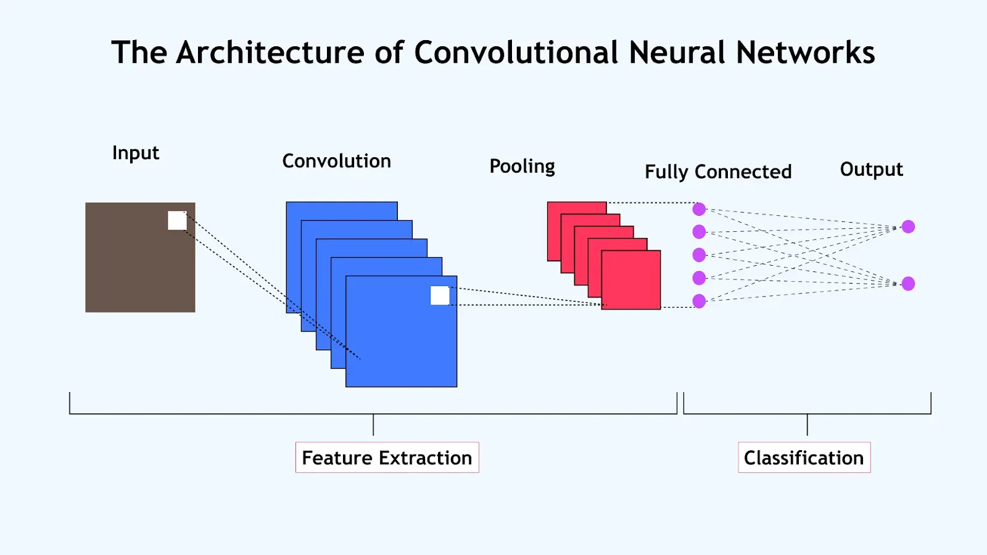
Structure of a Frame
Anatomy of a Data Frame:
Header - Contains metadata and control information
- Examples: Source & destination MAC addresses, frame type, length, priority flags
Payload (Data) - The actual content to be delivered
- Can be from the Network Layer or higher
Trailer - Often used for error detection (e.g., CRC, checksum)
- Helps identify corrupted or tampered frames
53
Dr. Shashi Bhushan

Slide 55
Fixed vs Variable Length Framing(a)
Why Different Framing Methods?
Different network protocols and environments require different methods for identifying the boundaries between frames.
Two major approaches: Fixed Length and Variable Length.
1. Fixed-Length Framing::
All frames are the same size.
Receiver knows exactly where each frame starts and ends.
Advantages: Simple to implement
Fast parsing and minimal overhead
Disadvantages: May waste bandwidth if the payload is smaller than the frame Not suitable for variable-size data
Example: ATM (Asynchronous Transfer Mode)
54
Dr. Shashi Bhushan

Slide 56
Fixed vs Variable Length Framing(b)
2. Variable-Length Framing::
Frame length varies based on data size.
Requires delimiters, headers, or length fields to detect boundaries.
Advantages: Efficient use of bandwidth
Ideal for dynamic traffic (e.g., web data, email)
Disadvantages: Requires more complex logic for parsing
Susceptible to framing errors if delimiters are corrupted
Example: Ethernet, PPP (uses length field); HDLC (uses flag-based framing)
55
Dr. Shashi Bhushan

Slide 57
Character-Oriented Framing(a)
What Is Character-Oriented Framing?
A method of framing where special byte values (characters) are used to indicate the beginning and end of a frame.
Often used in older text-based protocols (e.g., ASCII-based communication).
Frame Format Example::
| Start Flag (STX) | Payload | End Flag (ETX) |
STX = Start of Text (usually ASCII 0x02)
ETX = End of Text (usually ASCII 0x03)
56
Dr. Shashi Bhushan

Slide 58
Character-Oriented Framing(b)
Key Concepts::
Easy to implement when communicating in text-based formats.
Used where control characters can be interpreted reliably.
Problem: Character Confusion:
What if the data itself contains the same character as the delimiter (e.g., 0x02 or 0x03)?
This would cause the receiver to misinterpret actual data as frame boundaries.
Solution: Byte Stuffing
Special characters in the data are preceded by an “escape” character (ESC, e.g., 0x1B).
At the receiver end, ESC sequences are interpreted and restored to original data.
57
Dr. Shashi Bhushan

Slide 59
Byte Stuffing – Escaping Control Characters
What Is Byte Stuffing?
A technique used in character-oriented framing to prevent confusion between control characters (like frame delimiters) and data.
Adds a special escape character (ESC) before any occurrence of control characters within the data.
Why It’s Needed::
If the payload includes the same byte as the Start/End flag (e.g., STX = 0x02 or ETX = 0x03), the receiver may misinterpret it as a boundary.
Stuffing ensures that delimiters are only interpreted as framing marks if not escaped.
58
Dr. Shashi Bhushan

Slide 60
Bit-Oriented Framing(a)
What Is Bit-Oriented Framing?
A framing technique that uses specific bit patterns (not bytes or characters) to mark the start and end of a frame.
Offers better efficiency for transmitting binary data compared to character-oriented methods.
Frame Structure Example (HDLC)::
| Flag | Address | Control | Payload | FCS | Flag |
Flag: A unique 8-bit pattern used to denote frame boundaries (e.g., 01111110)
59
Dr. Shashi Bhushan

Slide 61
Bit-Oriented Framing(b)
Why Use Bit-Oriented Framing?:
Allows for data independence—any kind of binary data can be transmitted.
Common in high-performance, low-level data link protocols.
Problem: Bit Pattern Collision:
What if the data contains the same bit pattern as the flag (01111110)?
The receiver might mistake it for a frame boundary.
Solution: Bit Stuffing:
Insert a 0 after every five consecutive 1s in the data stream.
This prevents the accidental creation of the flag pattern.
Example:
Original data: 01111110 → Data collision risk Stuffed data: 011111010 → Safe transmission Receiver removes extra 0s when detecting five 1s.
60
Dr. Shashi Bhushan

Slide 62
Bit Stuffing – Preventing Flag Confusion in Bit-Oriented Framing
What Is Bit Stuffing?:
A technique used in bit-oriented framing to prevent confusion between data and control flags.
Ensures that the flag pattern (typically 01111110) does not appear in the payload.
How It Works::
The sender inserts a 0 after every five consecutive 1s in the payload. The receiver removes the 0 after every five 1s during de-stuffing.
Example: Flag: 01111110
Payload before stuffing: 011111101010→ Risk: Receiver might mistake 01111110 as a boundary
Stuffed Payload :0111110101010 → Safe: Only flag is interpreted as boundary
Framed Data: Flag | Stuffed Payload | Flag01111110 0111110101010 01111110
61
Dr. Shashi Bhushan

Slide 63
Header-Based Framing – Count Field Method
What Is Count-Based Framing?:
A framing technique where the length of the frame (or data portion) is included as a field in the header.
Allows the receiver to know exactly how many bytes to expect, removing the need for flags or delimiters.
Advantages:
Simple to parse
Efficient for fixed-format protocols
No need for bit or byte stuffing
Disadvantages:
If the length field is corrupted, the frame is misinterpreted
No synchronization markers if data is misaligned
Not ideal on noisy or lossy links
62
Dr. Shashi Bhushan

Slide 64
Error Detection(a)
What Is Error Detection?
A mechanism used in data communication to identify errors introduced during transmission.
Helps ensure that the received data matches what was originally sent.
Implemented at the Data Link Layer (and sometimes at higher layers too).
Types of Errors:
Single-bit error – Only one bit is altered
Burst error – A sequence of bits is altered (more common in real scenarios)
63
Dr. Shashi Bhushan

Slide 65
Error Detection(b)
Importance in Networking:
Helps prevent corrupted data from reaching applications
Enables retransmission or correction mechanisms
Improves reliability over noisy or shared channels
Basic Error Detection Techniques (Coming Up)::
Parity Bits (Simple & 2D)
Checksum
Cyclic Redundancy Check (CRC)
64
Dr. Shashi Bhushan

Slide 66
Parity Bit
What Is Parity?:
Parity is a basic error detection technique where a single bit is added to a data unit to make the total number of 1s either even or odd.
Used to detect single-bit errors during transmission.
65
Dr. Shashi Bhushan

Slide 67
Parity Bit – Simple and Two-Dimensional
1. Simple (Single) Parity::
Even Parity: Add 1 if total number of 1s is odd (to make it even)
Odd Parity: Add 1 if total number of 1s is even (to make it odd)
Example:
Data: 1010001 → Number of 1s = 3 (odd)
→ Even Parity Bit = 1 → Transmit: 10100011
2. Two-Dimensional Parity::
Data is arranged in rows and columns
Row parity and column parity bits are added
Can detect and often locate a single-bit error
Example:
Original Block:
| 1 | 0 | 1 | → Row Parity: 0
| 0 | 1 | 0 | → Row Parity: 1
Column Parity: 1 1 1
→ If a single-bit flips, the intersecting row and column reveal the location
66
Dr. Shashi Bhushan

Slide 68
Checksum Method – Concept and Example
What Is a Checksum?:
A simple error detection method where:
→ All data units (often words or bytes) are added together.
→ The result is complemented (inverted) and sent along with the data.
The receiver performs the same sum and compares its result with the transmitted checksum.
Example (8-bit checksum)::
Sender:
Data bytes: 11001010 + 10110101 = 1B7 (in hex)
Truncate carry: B7 → Complement: 48
Transmitted: [11001010] [10110101] [01001000] (Checksum)
Receiver:
Adds all three:
11001010 + 10110101 + 01001000 = 1FF
→ Truncate carry: FF → Complement = 00 (all bits 0) → Valid
67
Dr. Shashi Bhushan

Slide 69
Cyclic Redundancy Check (CRC) – Concept
What Is CRC?:
A robust error detection method that treats data as a binary number (polynomial).
The sender divides the data by a generator polynomial and appends the remainder (CRC bits) to the frame.
The receiver performs the same division — if remainder = 0, no error is detected.
Key Concepts::
CRC detects burst errors more effectively than parity or checksum.
Common CRC generators:
CRC-8, CRC-16, CRC-32 (used in Ethernet, ZIP files, etc.)
68
Dr. Shashi Bhushan

Slide 70
Cyclic Redundancy Check (CRC)
RC Operation (High-Level Steps):
Append (n−1) zeros to the data, where n = degree of generator polynomial.
Divide the resulting bitstream by the generator polynomial using modulo-2 division (XOR).
The remainder is the CRC — added to the original data.
Receiver repeats the division:
→ If remainder = 0 → Data is valid
→ Else → Error detected
Notation Example::
Data: 1101011011
Generator (key): 10011 (degree = 4)
→ Append 0000 to data → Divide → Remainder = CRC (e.g., 1000)
69
Dr. Shashi Bhushan

Slide 71
CRC Calculation – Step-by-Step Example
Example Setup::
Data: 100100
Generator (Key): 1101 (degree 3 → append 3 zeros)
Step 1: Append (n−1) zeros to data
→ 100100 → becomes 100100000
Step 2: Perform Modulo-2 Division (XOR):
Divisor (key): 1101
Dividend: 100100000
Perform binary division using XOR:
Start with leftmost bits equal in length to the key
XOR the segment with key
Bring down the next bit and repeat
Step-by-step XOR:
1001 (from data)⊕ 1101 (key)
= 0100 → bring down next bit (0) → 100
⊕ 110 → …continue process
Final Remainder (CRC): e.g., 101
Step 3: Append CRC to data
Transmitted Frame: 100100 + 101 = 100100101
70
Dr. Shashi Bhushan

Slide 72
Comparison of Error Detection Methods
Feature / Method | Parity Bit | Checksum | CRC
Detection Ability | Detects single-bit | Detects many errors | Detects burst & complex errors
Correction Ability | No | No | No
Complexity | Very low | Low | Moderate
Overhead | 1 bit (simple parity) | 1 word | n bits (depends on polynomial)
Performance | Fast | Fast | Efficient & reliable
Real-World Use | RAM, serial links | TCP/UDP, IP headers | Ethernet, USB, file formats
71
Dr. Shashi Bhushan

Slide 73
Hamming Code – Error Correction Concept
What Is Hamming Code?:
A forward error correction technique that not only detects errors but also corrects single-bit errors.
Introduced by Richard Hamming in 1950.
Uses parity bits placed at specific positions in the data to compute error location.
Example Format (7-bit Hamming Code for 4-bit data)::
P1 covers positions 1, 3, 5, 7
P2 covers positions 2, 3, 6, 7
P3 covers positions 4, 5, 6, 7
Position | 1 | 2 | 3 | 4 | 5 | 6 | 7
Bit Type | P1 | P2 | D1 | P3 | D2 | D3 | D4
72
Dr. Shashi Bhushan

Slide 74
Calculating Redundant Bits for Hamming Code
Hamming Code Redundancy Rule::
To determine how many parity (redundant) bits are required for a given number of data bits (m), use the inequality:
2^r ≥ m + r + 1
Where:
r = number of redundant (parity) bits
m = number of data bits
Example:
Suppose m = 4 (we want to encode 4 data bits)
→ Find r such that:
2^r ≥ 4 + r + 1
Try r = 3:
2^3 = 8 ≥ 4 + 3 + 1 = 8 → Valid
→ So, 3 redundant bits are needed for 4 data bits (total = 7-bit Hamming Code)
Data Bits (m) | Redundant Bits (r) | Total Bits (m + r)
4 | 3 | 7
7 | 4 | 11
11 | 4 | 15
26 | 5 | 31
73
Dr. Shashi Bhushan

Slide 75
Hamming Code – Encoding Example
Example: Encode 4-bit data = 1011 using Hamming(7,4):
Step 1: Determine Positions
Total bits = 7 (4 data + 3 parity)
Position layout (left to right):
| 1 | 2 | 3 | 4 | 5 | 6 | 7 |
| P1| P2| D1| P3| D2| D3| D4|
→ Place data bits:
D1 = 1, D2 = 0, D3 = 1, D4 = 1
→ Initial frame:
[ _ P1 _ P2 _ D1 _ P3 _ D2 _ D3 _ D4 ]
= [ _ _ 1 _ 0 1 1 ]
Step 2: Calculate Parity Bits
P1 (positions 1,3,5,7) → bits: 1,0,1 → P1 = 0 (even parity)
P2 (positions 2,3,6,7) → bits: 1,1,1 → P2 = 1
P3 (positions 4,5,6,7) → bits: 0,1,1 → P3 = 0
→ Final Frame:[P1 P2 D1 P3 D2 D3 D4] = [0 1 1 0 0 1 1]
Final Encoded Hamming(7,4) Code: 0 1 1 0 0 1 1
74
Dr. Shashi Bhushan

Slide 76
Hamming Code – Decoding and Error Correction
Received Example::
Assume transmitted Hamming(7,4) frame = 0110011
Now suppose a 1-bit error occurs → Receiver gets: 0010011
Step 1: Recalculate Parity Bits
Bit positions:
| 1 | 2 | 3 | 4 | 5 | 6 | 7 |
| P1| P2| D1| P3| D2| D3| D4 |
Recalculate each parity bit using its covered positions:
P1 checks bits 1, 3, 5, 7 → 0,1,0,1 → 0 parity = Correct
P2 checks bits 2, 3, 6, 7 → 0,1,1,1 → 1 parity = Correct
P3 checks bits 4, 5, 6, 7 → 0,0,1,1 → 0 parity = Correct
→ All parity bits correct? No — in this case, one parity is incorrect
→ Let's try an example with a flipped bit at position 3: 0100011
Step 2: Identify Error Position
Assume parity check results:
P1 incorrect (1)
P2 correct (0)
P3 incorrect (1)
→ Error position = Binary 101 = 5
→ Flip bit at position 5 to correct
Step 3: Extract Data Bits
From corrected frame:
| D1 | D2 | D3 | D4 | = bits at positions 3, 5, 6, 7
75
Dr. Shashi Bhushan

Slide 77
Burst Error Handling Overview
What Is a Burst Error?:
A burst error occurs when two or more consecutive bits in a data unit are altered during transmission.
More difficult to detect and correct than isolated single-bit errors.
Characteristics:
Common in wireless and noisy environments.
Often caused by interference, sudden power changes, or synchronization loss.
Length of a burst = from the first corrupted bit to the last (not just the number of erroneous bits).
76
Dr. Shashi Bhushan

Slide 78
Handling Burst Errors
Example:
Original: 10011101
Received: 10110111
→ Error from bit position 2 to 5 → Burst length = 4
Strategies for Handling Burst Errors:
Block-Based Coding:
Data is grouped into blocks with additional check bits.
Burst errors affect fewer blocks → easier to isolate.
Interleaving:
Rearranges data bits before transmission to spread out burst errors.
Makes errors appear as random single-bit errors when de-interleaved.
CRC:
Excellent for detecting burst errors (length ≤ degree of polynomial).
Used in Ethernet, storage devices.
77
Dr. Shashi Bhushan

Slide 79
Error Detection vs Error Correction
Feature / Technique | Parity Bit | Checksum | CRC | Hamming Code
Type | Detection | Detection | Detection | Detection & Correction
Detects Single-Bit Errors | Yes | Yes | Yes | Yes
Detects Burst Errors | No (limited) | Moderate | Excellent | Limited
Corrects Errors | No | No | No | Yes (1-bit)
Complexity | Very Low | Low | Medium | Medium
Redundancy/Overhead | 1 bit | 1 word | Multiple bits | Multiple bits
Used In | RAM, Serial Links | IP, TCP/UDP | Ethernet, USB | Memory, Embedded
78
Dr. Shashi Bhushan

Slide 80
Introduction to Flow Control
What Is Flow Control?
A mechanism to manage the rate of data transmission between two devices.
Ensures that a fast sender does not overwhelm a slower receiver.
Why It’s Important::
Devices often operate at different speeds or capacities.
Without flow control, data may be lost if the receiver’s buffer overflows.
Flow control preserves data integrity and network efficiency.
79
Dr. Shashi Bhushan

Slide 81
Flow Control(b)
Where It Occurs:
Implemented at the Data Link Layer (local flow control)
Also at the Transport Layer (e.g., TCP windowing)
Key Objectives:
Prevent receiver buffer overflow
Ensure efficient use of bandwidth
Maintain synchronization between sender and receiver
Common Flow Control Strategies:
Stop-and-Wait
Sliding Window (to be discussed in upcoming slides)
80
Dr. Shashi Bhushan

Slide 82
Stop-and-Wait Flow Control
What Is It?:
A basic flow control technique where the sender transmits one frame and waits for an acknowledgment (ACK) before sending the next.
Process:
Sender transmits a frame.
Receiver receives and sends back an ACK.
Only after receiving the ACK does the sender transmit the next frame.
Example:
Sender: → Frame 1 → (wait) ← ACK 1 ←
→ Frame 2 → (wait) ← ACK 2 ←
81
Dr. Shashi Bhushan

Slide 83
Sliding Window Protocol – Introduction
What Is Sliding Window Protocol?:
A flow control mechanism that allows the sender to send multiple frames before requiring an acknowledgment.
Uses a “window” to define how many unacknowledged frames can be in transit.
Why It’s Better Than Stop-and-Wait::
Improves channel utilization
Allows continuous data flow
Reduces idle time at sender
82
Dr. Shashi Bhushan

Slide 84
Sliding Window – Example
Example Setup::
Window size = 4
Sender wants to send frames numbered 0–7
Initial sender window: 0, 1, 2, 3
Receiver can accept frames in order and send ACKs
Transmission Flow:
Step 1:Sender sends frames 0, 1, 2, 3→ No ACKs yet; window is full
Step 2:Receiver receives frames and sends ACK 0, ACK 1
Step 3:Sender receives ACK 0→ Window slides: now can send frame 4→ Sender window: 1, 2, 3, 4
Step 4:ACK 1 arrives→ Window slides again: frame 5 now allowed→ Sender window: 2, 3, 4, 5
… and so on
83
Dr. Shashi Bhushan

Slide 85
Media Access Control (MAC)
What Is MAC?
Media Access Control is the sublayer of the Data Link Layer responsible for regulating access to a shared communication medium.
Ensures that multiple devices can communicate over the same channel without interference or data collision.
MAC in the OSI Model::
Data Link Layer is divided into:
Logical Link Control (LLC): Handles error checking and frame synchronization
Media Access Control (MAC): Manages access to the medium and hardware addressing
84
Dr. Shashi Bhushan

Slide 86
MAC Addressing – Format and Function
What Is a MAC Address?
A unique hardware address assigned to each Network Interface Card (NIC)
Also known as a physical address or hardware address
Used to identify devices on the same local network
Format:
48 bits (6 bytes) long
Written in hexadecimal: 00:1A:2B:3C:4D:5E or 00-1A-2B-3C-4D-5E
First 24 bits: Organizationally Unique Identifier (OUI) assigned to manufacturer
Last 24 bits: Device-specific identifier (NIC serial number)
Example :
MAC Address: 00:14:22:01:23:45
00:14:22 → Assigned to Dell
01:23:45 → Unique device ID
85
Dr. Shashi Bhushan

Slide 87
MAC vs IP:
Feature | MAC Address | IP Address
Layer | Data Link Layer | Network Layer
Permanence | Usually fixed | Can change (dynamic)
Scope | Local (LAN only) | Global (WAN/LAN)
Format | Hexadecimal | Dotted decimal (IPv4)
86
Dr. Shashi Bhushan

Slide 88
Contention-Based MAC – Introduction to CSMA
What Is Contention-Based Access?:
A method where multiple devices share the same communication channel and compete (contend) for access.
No centralized control — devices must listen and coordinate access themselves.
Key Principle: Carrier Sense Multiple Access (CSMA):
Carrier Sense: Device listens to the medium before transmitting.
Multiple Access: Many devices use the same medium.
Goal: Minimize collisions by sensing before sending.
87
Dr. Shashi Bhushan

Slide 89
Introduction to CSMA(b)
Variants of CSMA::
CSMA/CD (Collision Detection) – Used in wired Ethernet (legacy)
CSMA/CA (Collision Avoidance) – Used in wireless LANs (Wi-Fi)
Basic CSMA Process: :
Device checks if channel is idle (Carrier Sense)
If idle → transmit
If busy → wait, then retry after random backoff
Advantages:
Efficient in light network traffic
Decentralized, simple to implement
Disadvantages:
Risk of collision in high traffic
Performance degrades as number of devices increases
88
Dr. Shashi Bhushan

Slide 90
CSMA/CD – Collision Detection in Wired Networks
What Is CSMA/CD?:
Carrier Sense Multiple Access with Collision Detection
A method used in wired Ethernet (especially 10BASE-T and 100BASE-T) to detect and recover from collisions when two devices transmit simultaneously.
How It Works::
Carrier Sense:→ Device listens to the channel before sending.
Transmit:→ If the channel is idle, transmission begins.
Collision Detection:→ While transmitting, the device listens for voltage changes (collision).→ If detected → transmission stops immediately.
Backoff:→ Both devices wait a random amount of time (exponential backoff).→ After delay, devices retry transmission.
89
Dr. Shashi Bhushan

Slide 91
CSMA/CA – Collision Avoidance in Wireless Networks
What Is CSMA/CA?:
Carrier Sense Multiple Access with Collision Avoidance
Used in wireless LANs (Wi-Fi) to minimize the chance of collisions before they happen
Why Collision Avoidance?:
Unlike wired Ethernet, wireless devices cannot always detect collisions (hidden node problem)
So, instead of detecting collisions, Wi-Fi tries to avoid them
How CSMA/CA Works?
Carrier Sense:→ Device listens to the wireless channel
If idle:→ Waits a random backoff time (Contention Window)→ Sends a frame if channel remains idle
Optional RTS/CTS (Request to Send / Clear to Send):Helps reserve the channel before actual data transmissionMinimizes collision risk from hidden nodes
ACK:→ Receiver sends an acknowledgment if the frame is received successfully
90
Dr. Shashi Bhushan

Slide 92
CSMA/CD vs CSMA/CA – Comparison
Feature | CSMA/CD (Collision Detection) | CSMA/CA (Collision Avoidance)
Used In | Wired Ethernet (legacy) | Wireless LAN (Wi-Fi – IEEE 802.11)
Collision Handling | Detects collision and stops transmission | Avoids collision before transmission
Sensing Method | Listens and transmits simultaneously | Listens before transmitting
ACK Required | No (frames assumed successful) | Yes (ACK required to confirm reception)
RTS/CTS Mechanism | Not used | Optional (helps avoid hidden node issue)
Efficiency in High Traffic | Lower due to frequent collisions | Higher due to collision avoidance
Physical Media | Coaxial cables, shared wires | Wireless radio waves
Modern Usage | Rare (replaced by full-duplex switches) | Widely used in Wi-Fi
91
Dr. Shashi Bhushan

Slide 93
Controlled Access Methods – Polling & Token Passing
What Is Controlled Access?:
Devices transmit only when permitted, avoiding collisions entirely.
Common in environments requiring order, predictability, or centralized control.
Polling:
A central controller sequentially asks each device if it has data to send.
Efficient when few devices are active.
Token Passing::
A token (special frame) circulates in the network.
Only the device holding the token may transmit.
After transmission, the token is passed to the next node.
92
Dr. Shashi Bhushan

Slide 94
MAC Protocols – Comparison Table
Feature | CSMA/CD | CSMA/CA | Polling | Token Passing
Access Type | Contention | Contention | Controlled | Controlled
Medium Type | Wired (Ethernet legacy) | Wireless (Wi-Fi) | Wired (Industrial) | Ring/Bus Topologies
Collision Handling | Detects after transmit | Avoids before transmit | No collisions | No collisions
Fairness | Medium | Medium | High (controller decides) | High (token rotation)
Efficiency (load) | Degrades with traffic | Degrades with traffic | Efficient if low traffic | Efficient but token delay
Complexity | Low | Moderate (RTS/CTS, ACK) | Moderate (controller needed) | High (token mgmt needed)
93
Dr. Shashi Bhushan

Slide 95
MAC Address Filtering & Table Management
MAC Address Filtering::
Restricts network access based on MAC address.
Common in Wi-Fi routers and enterprise switches.
MAC Table Example:
MAC Address | Port
00:11:22:AA:BB:01 | 1
00:11:22:AA:BB:02 | 2
94
Dr. Shashi Bhushan

Slide 96
MAC Address Conflicts – Causes
What Is a MAC Conflict?
Occurs when two devices on the same LAN have the same MAC address.
Leads to unpredictable behavior — data may go to the wrong device or be dropped.
Common Causes::
MAC spoofing (malicious or accidental)
Cloning (e.g., two virtual machines with same MAC)
Misconfigured devices (e.g., reused NIC images in VM deployments)
Faulty firmware or duplicate factory assignments
95
Dr. Shashi Bhushan

Slide 97
MAC Address Conflicts – Detection & Resolution
Detection & Resolution::
Use arp -a (Windows) or ip neigh (Linux) to check IP–MAC bindings
Use switch CLI (show mac address-table) to identify MAC collisions across ports
Change MAC address on one of the conflicting devices (if spoofed)
Check DHCP server logs for duplicate MACs
Symptoms:
Intermittent connectivity
ARP table inconsistencies
Packets looping, dropped, or misrouted
96
Dr. Shashi Bhushan

Slide 98
CLI Tools – Inspecting MAC and Layer 2 Information
Windows:
ipconfig /all → Shows MAC address (Physical Address)
arp -a → Lists IP-to-MAC mappings (ARP cache)
getmac → Lists MAC addresses of local interfaces
Example (Windows)::
ipconfig /all
→ Ethernet adapter:
Physical Address . . . . . . . . : 00-11-22-AA-BB-CC
arp –a
→ Internet Address Physical Address Type
192.168.1.1 00-11-22-AA-BB-CC dynamic
97
Dr. Shashi Bhushan

Slide 99
Wireshark Overview – Capturing MAC-Layer Frames
What Is Wireshark?:
A free, open-source network protocol analyzer
Captures and displays network traffic in real time
Useful for inspecting Layer 2 (Data Link) headers including MAC addresses
What You Can Observe:
Ethernet frame structure (Destination MAC, Source MAC, Type, Payload)
ARP, STP, and MAC broadcast traffic
Duplicate MAC addresses or spoofing attempts
CSMA/CD retransmissions or dropped frames (in legacy or emulated setups)
98
Dr. Shashi Bhushan

Slide 100
Wireshark Overview – Capturing MAC-Layer Frames
Basic Steps::
Select correct network interface
Start capture
Filter for protocols (e.g., eth, arp, stp)
Inspect Frame → Ethernet II → Source/Destination MACs
Example Filter::
eth.addr == 00:11:22:AA:BB:CC
Useful Filters:
Arp
eth.src == aa:bb:cc:11:22:33
eth.dst == ff:ff:ff:ff:ff:ff (broadcast)
99
Dr. Shashi Bhushan

Slide 101
Wired vs Wireless MAC Behavior – Ethernet vs Wi-Fi
Ethernet (Wired LAN)::
Medium: Dedicated cable per device (switch-based)
Access Control: CSMA/CD (obsolete in switched networks)
Collision Domain: One per switch port
Efficiency: High due to full-duplex
MAC Frames: Ethernet II format (Destination MAC, Source MAC, Type, Payload, CRC)
Wi-Fi (Wireless LAN)::
Medium: Shared radio frequency
Access Control: CSMA/CA (Collision Avoidance)
Collision Domain: All stations in range
Efficiency: Variable, affected by interference and range
MAC Frames: IEEE 802.11 format (includes Frame Control, Duration, Addr1–3)
100
Dr. Shashi Bhushan

Slide 102
Physical Layer vs Data Link Layer
Feature / Task | Physical Layer (Layer 1) | Data Link Layer (Layer 2)
Unit of Data | Bit | Frame
Role | Transmit raw signals | Format & deliver frames
Key Function | Signal encoding, transmission | Framing, error detection, MAC addressing
Devices | Cables, hubs, repeaters | Switches, NICs, bridges
Media Type | Electrical, optical, wireless | N/A (relies on Layer 1)
Addressing | None | MAC address
Visibility in Wireshark | Signal-level: Not visible | Yes – frame headers are visible
101
Dr. Shashi Bhushan

Slide 103
Frame Formats – Ethernet vs Wireless (802.11)
Ethernet Frame (IEEE 802.3 – Ethernet II):
Field | Description
Preamble | Synchronization (7 bytes)
Start Frame Delimiter | Marks start of frame (1 byte)
Destination MAC | 6 bytes
Source MAC | 6 bytes
Type/Length | 2 bytes (protocol or size)
Data (Payload) | 46–1500 bytes
Frame Check Sequence | CRC (4 bytes)
44
Dr. Shashi Bhushan

Slide 104
Frame Formats – Ethernet vs Wireless (802.11)
Wi-Fi Frame (IEEE 802.11):
Field | Description
Frame Control | Type, subtype, control flags
Duration/ID | Time slot reservation
Address 1 (Receiver) | Destination MAC
Address 2 (Transmitter) | Source MAC
Address 3 (BSSID/AP) | Intermediate or AP MAC
Sequence Control | Frame numbering
Data | Payload
Frame Check Sequence | CRC (4 bytes)
44
Dr. Shashi Bhushan

Slide 105
Thank You
44
Dr. Shashi Bhushan

